Slide 1
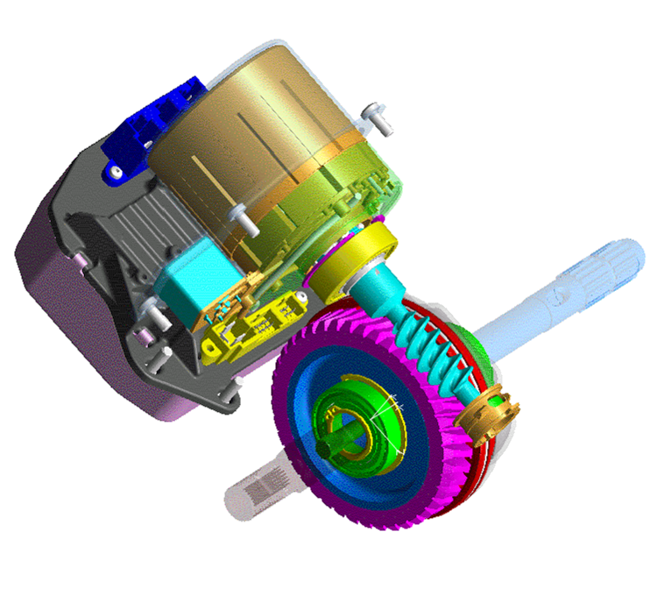
MDPS (TRW)

Slide 2
Introduction
Application
Model | Engine | Gen | M/East | EU | Aust. | CAN | USA
TB F/L (’05.6) | ε-1.1 | O | O | O
 | α -1.4 | O | O | O | -
 | α -1.6 | O | O | O | -
 | U-1.5 | S | S | S
MC | α -1.4 | S | S | S
 | α -1.6 | S | S | S | - | - | -
 | U-1.6 | S | S | S
HD | γ-1.6 | S | S | S | - | - | -
 | β-2.0 | S | S | S | S | S | S
 | U-1.6 | S | S | S | - | - | -
Item | MC | HD
Max. Current | 65A | 78A
Diameter [D] | Φ76mm | Φ86.5mm
Length [L] | 125mm | 55mm
Weight | 2.6kg | 2kg
Rated torque | 34N.m | 58N.m
Motor type | D/C | A/C
Applied in both LHD and RHD as a standard including North American market.
TRW GEN2 (Model name)
Smaller and light motor applied
Higher torque capacity
Notes:
TRW Gen2 모델임. 르노 메간, 모두스에 기 장착되어 양산된 제품임.
TRW기술로 모비스가 양산.
가솔린엔진(감마,베타) 및 디젤엔진 간 모터나 구성품의 차이 없음. (감속 기어비도 똑같음)

Slide 3

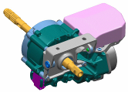
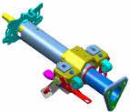
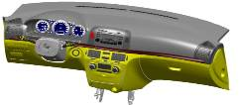
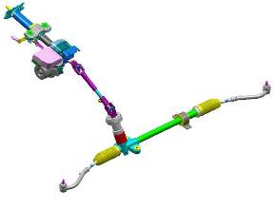

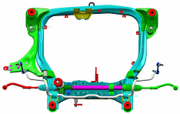
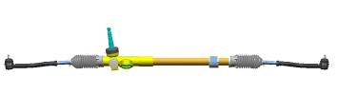
Introduction
System structure
②
①
LWR MT’G BRKT
Power Head
MOBIS
COCKPIT MODULE
Steering Column
③
MDPS SYSTEM
MOBIS
④
U/Joint
CHASSIS MODULE
MOBIS
Steering Gearbox
Notes:
컬럼샤프트도 분해 금지임. 기본적으로 MDPS Ass’y 전체 교환이나 양산 이후, ECM만은 교환 가능토록 변경 예정.

Slide 4
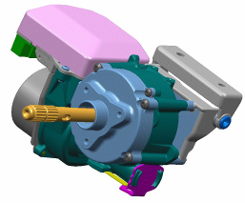
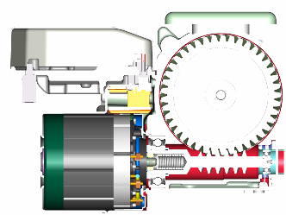
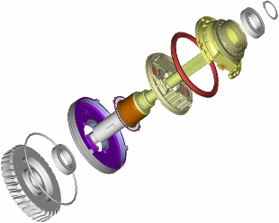
Components
Power head
ECU
Worm Wheel
To column
To U/Joint
ASS’Y exterior
Dust Cover
Light Guide
PCB
Motor
Spring
Bearing
Worm Gear
O-Ring
Circle Lip
ASS’Y section view
Bearing
Quill Shaft Ass’y
Disk
Bearing
Worm Wheel
Sensor deploy view

Slide 5
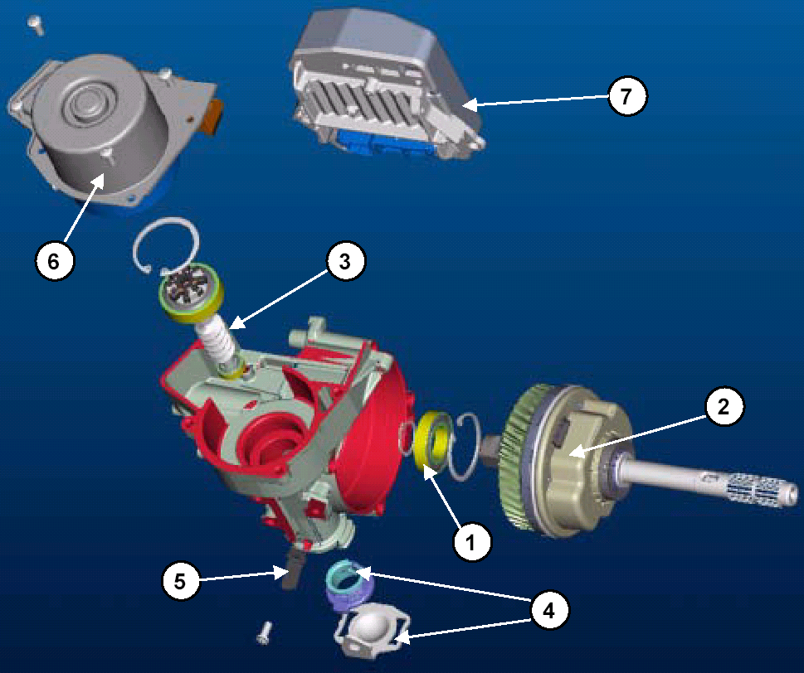
Components
Power head
ECU
Motor
Worm Shaft Assy
Worm Wheel
Main Housing
Sensor Ass’y
Bearing
Anti-Rattle Spring
Oval Ring & Cover

Slide 6

System Control
Control logic
▶ Main input signals for the control logic
① Steering Wheel Torque
② Steering Wheel Position (Angle)
③ Vehicle Speed
Assistance
Boost Curve
Torque
VSS
Angle
Motor
Command
Active
Return
+
VSS
Torque
Yaw
Damping
Angle
VSS
Notes:
기본적으로 기존 차량은 토크만 있으면 모터 Assist가 가능하므로 Angle값은 따로 검출하지 않았으나 HD는 조향각값을 검출하여 복원제어 및 댐핑제어에 활용함,
따라서 조향각의 Calibration이 필요한 것.
이것이 기존 시스템과의 가장 큰 차이임.

Slide 7
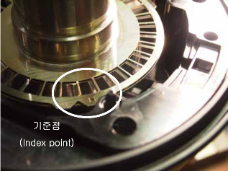
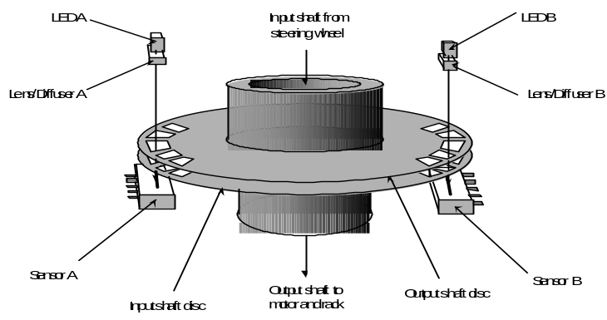
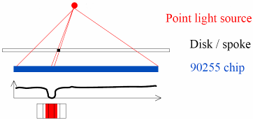

System Control
Torque sensor principle
Narrow spoke disk
wide spoke disk
Index point
LA A
LA B
Angle & torque sensor
Gear Box
Motor position sensor
Motor
128 pixel
Rack & Pinion Gear
Linear Array
Notes:
토크센서는 외부 결선이 없기 때문에 파형 측정 및 고장진단은 불가함.

Slide 8
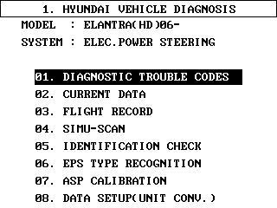
System Control
ASP (Absolute Steering Position) calibration
When ?
MDPS Assmbly was replaced with new one or used one from the other vehicles.
MDPS ECM (TBD) was replaced with new one or used one from the other vehicles.
After wheel alignment adjustment.
Notes:
울산 양산 라인에서 모비스로 부터 입고된 신품 앗세이를 차량에 장착하면 최초에는 경고등이 깜박거린다고 함 (울산 차량 생기2팀 확인완료)

Slide 9
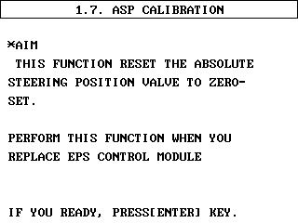
System Control
ASP (Absolute Steering Position) calibration
How?
Ignition key ON (engine off) and set the front tire and steering wheel on the center (neutral) position.
- For lower steering effort, IG ON(engine run) → IG off and on whithin 2∼3 seconds.
Connect the scanner and Enter into the ‘ASP calibration’ menu on the scanner.

Slide 10
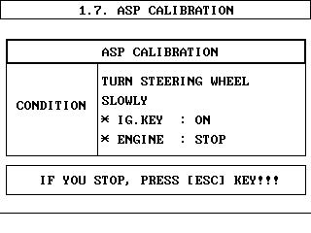
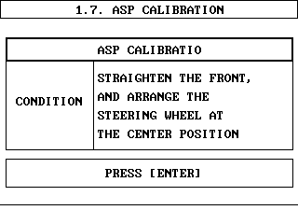
System Control
ASP (Absolute Steering Position) calibration
How?
3) Rotate the steering wheel more than ±180°(Left and right) from the center position
- To detect the location of index point.
4) Rotate the steering (left and right) wheel until the screen in the scanner becomes as below. That is, if the index point is detected, the next procedure will be followed automatically.
Scanner will skip this procedure if the index point already detected !

Slide 11
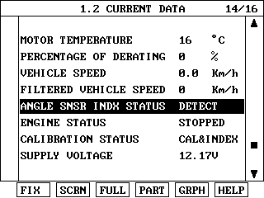
System Control
ASP (Absolute Steering Position) calibration
How?
5) Set the front tire and steering wheel on the neutral position (±2°) and press enter key in the scanner. .
6) Press the esc key and move to the current data in order to confirm the calibration status.
‘Detect’ or ‘Not detect’:
Every IG off & on, this value will show ‘detect’ or ‘not detect’ depending on the steering wheel position. But it will get ‘detect’ naturally as the steering wheel is rotated more than 180° while driving. (‘not detect’ does not mean the calibration fault.)
  CAL&INDEX: Calibration is OK and Index was found.

Slide 12
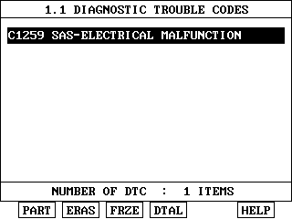
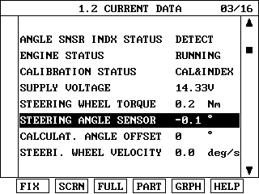
System Control
ASP (Absolute Steering Position) calibration
How?
7) Finally check the system rotating the steering wheel and also DTC must be checked. If you have following DTC after ASP calibration, it means that the steering wheel neutral position was excessively out of specification (step ‘1’) and you have to try again from the first step.
Angle Sensor Fault
After DTC detection, the angle value will be fixed by zero.
Notes:
최대 조향각이 580도 정도를 초과하면 Angle Sensor Fault를 감지한다. 경고등은 점등되지 않으나,
진단정비에 표출되는 Steering Angle값은 0도로 고정된다. 즉, 토크는 정상적으로 감지하여 Motor Assist는 되지만,
조향각 정보는 중립으로 고정되기 때문에 정상적인 복원제어는 할 수 없다.
최종적으로 점검하는 방법은 Steering angle값이 0도(중립)으로 부터 580도미만 인지(풀턴시) 확인한다.(한쪽만 확인해 보면 된다)

Slide 13
System Control
ASP (Absolute Steering Position) calibration
What happen if it is not done?
In case of replacement with new part
- Motor assist is available but warning lamp will blink and active return (on-center control) will stop.
2) In case of replacement with used part
- Motor assist is available and warning lamp will not turn on. Active return (on-center control) will stop.
What happen if it was done with wrong way? (improper steering wheel center position)
- You may have DTC (C1259) without warning lamp on. However, the motor assist is available but the active return (on-center control) will stop.
Notes:
울산 양산 라인에서 모비스로 부터 입고된 신품 앗세이를 차량에 장착하면 최초에는 경고등이 깜박거린다고 함 (울산 차량 생기2팀 확인완료)
즉, 필드의 경우 신품으로 교환하고 Calibration 하지 않으면 경공등 깜박거리고 DTC도 저장됨.

Slide 14
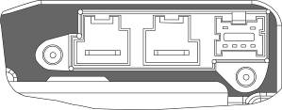
System Control
Input & Output
1
2
7
8
6
5
4
3
Symbol | Description | Pin No. | Reference
Vbatt | Battery(+) | 1
GND | Battery(-) | 2
CAN_BUS | CAN High | 3 | CAN 2.0B, 500kbps
CAN_BUS | CAN Low | 6 | CAN 2.0B, 500kbps
CAN_BUS | CAN High | 7 | Not used
CAN_BUS | CAN Low | 4 | Not used
IGN | Ignition switch input | 5
NC | Spare | 8 | Not used

Slide 15
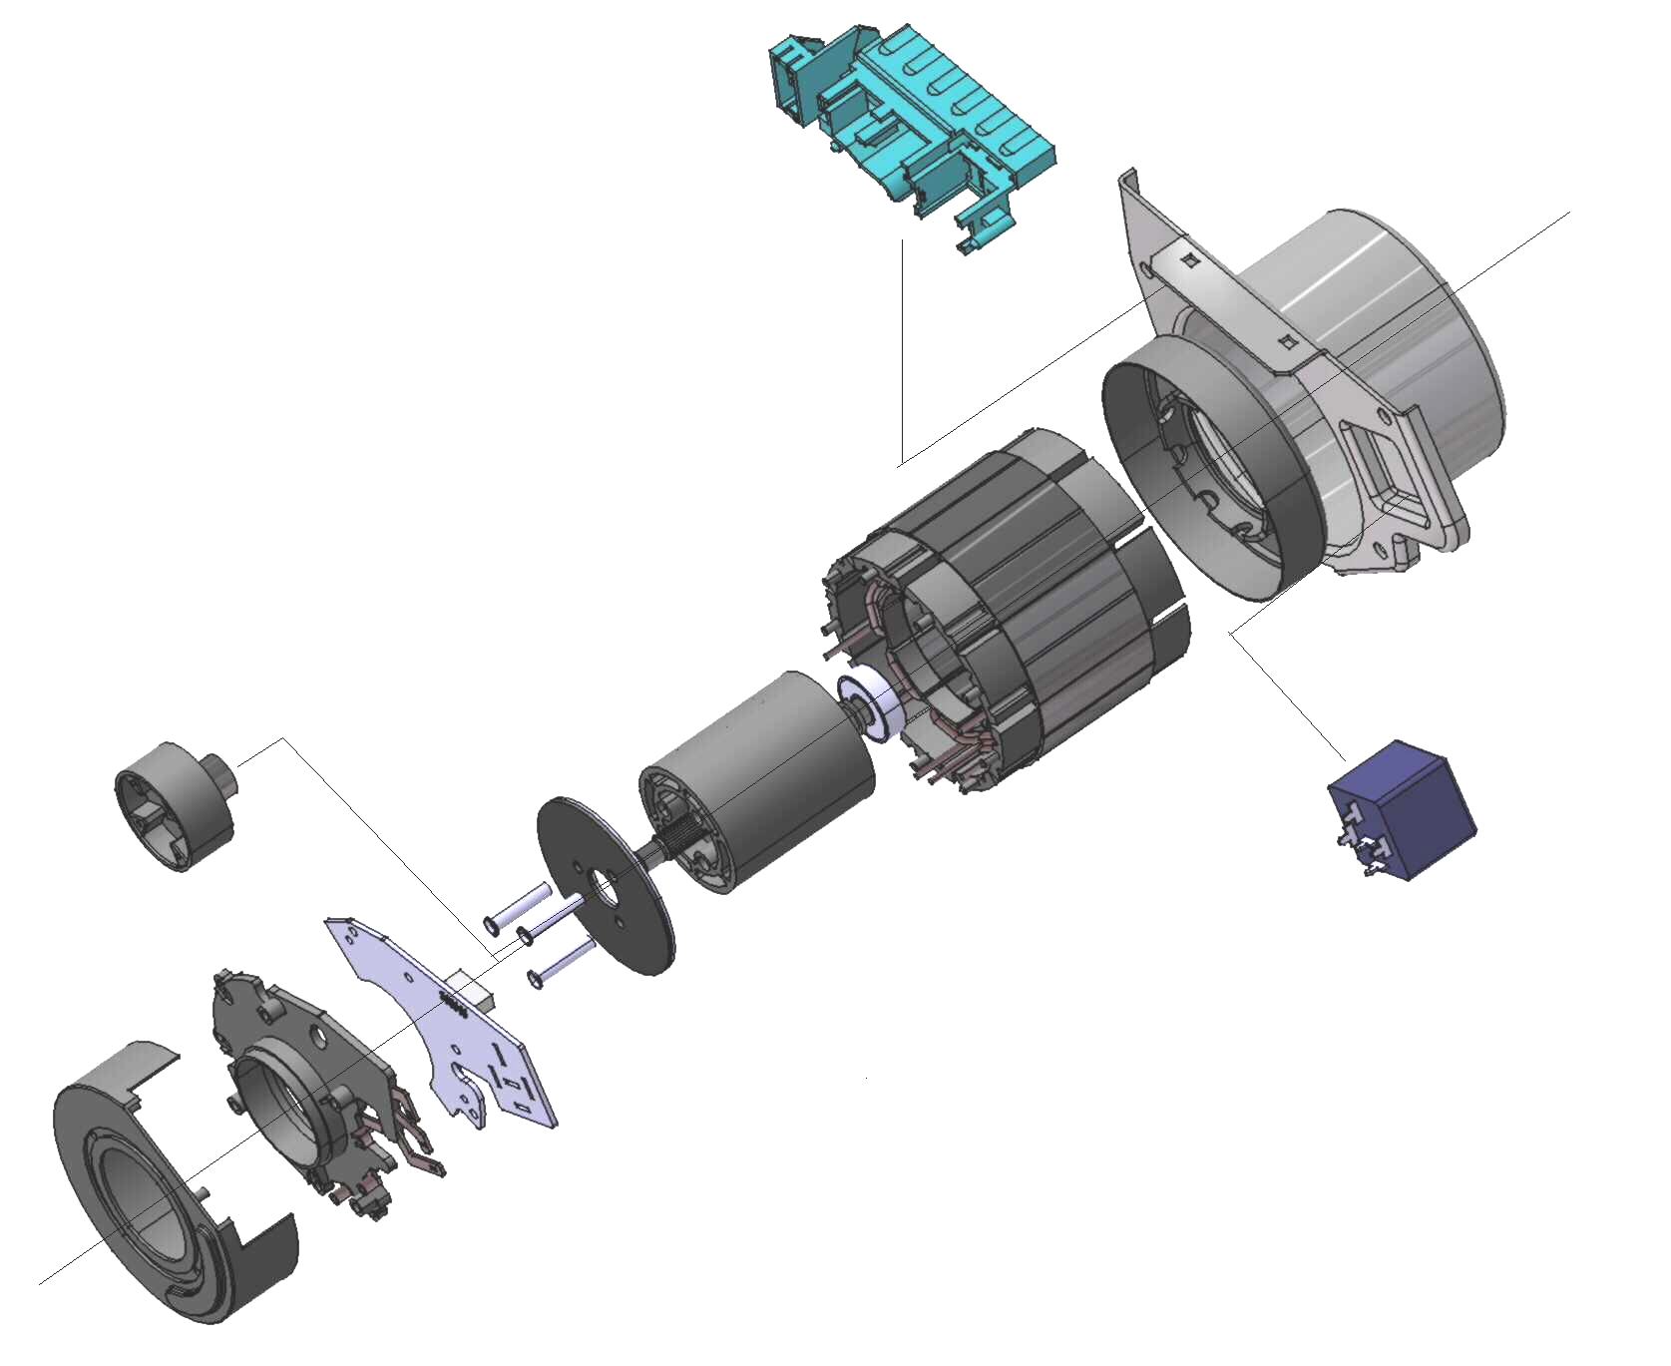
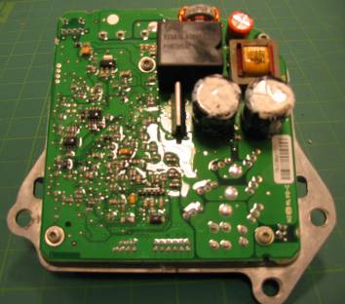
System Control
Power supply & Relay
ECM relay (built in ECM)
Motor relay (built in motor)
Every ignition off from engine running, the relay will sound (off) after 2∼3 seconds.
However, if you turn the ignition on before 2∼3 seconds, the motor assist is available under the ignition on condition even though the engine is not running.

Slide 16
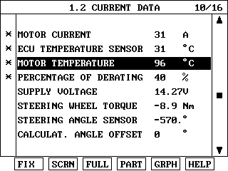
System Control
Overheat Protection (Derating motor current )
Before the DTC(C1603) is detected (before the temperature reaches 85°), as soon as the steering torque reaches to maximum value, the motor current will decrease by 40% immediately in order to prevent the overheat in the system in advance.
Notes:
최대로 조향휠을 꺽자마자 40%로 다운됨 (78A X 40% = 31A)
모터 온도가 아니고 ECM온도가 85이상이라야 고장코드 감지됨.
식으면 자동으로 고장코드 소거 된다고 함.
ECM내부에 별도의 온도 감지센서가 있으나, 진단장비에 표출되는 모터 온도는 간접 계산치임.

Slide 17
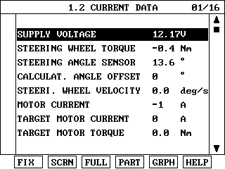
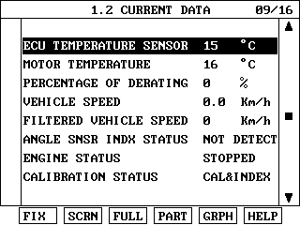
Diagnosis
Understanding of service data
Compensation value
- Stopped
- Cranking
- Running

Slide 18
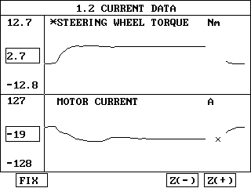
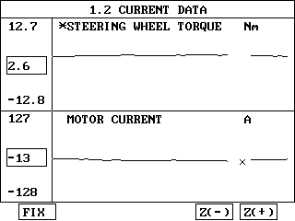
Diagnosis
Failsafe for vehicle speed signal fault
The vehicle speed signal comes from PG-B in A/T through PCM(or TCM) and CAN.
Warning lamp OFF, No DTC and Motor ON (Default vehicle speed is 40km/h)
Normal condition
PG-B open circuit
Notes:
차량은 주행 중 가다 서다를 반복하기 때문에 기존차량(TB,MC)은 차속센서 고장코드 감지를 위해 별도의 고장 감지 조건이 있었으나
HD는 차속 신호를 잃어도 별도의 고장코드가 없고 40km/h로 고정 제어한다. 위와 같이 PG-B를 단선시키면 전류값이 약간 떨어지는 것을
알 수 있다.

Slide 19
Diagnosis
Failsafe for IGN1 signal fault
- IG1 signal is used to detect the engine status (not for the MDPS ECM system power)
Items | While engine running | Before engine start
Failure | Ignition signal open circuit
Warning lamp | X | O
Motor Assist (while engine run) | O | X
DTC | C1103 | C1103
Failsafe for engine speed signal fault
For example, disconnect the CKP sensor while driving and confirm the symptom.
- Warning lamp ON (IG On condition),
- No DTC
- Motor assist ON for 30 seconds and turn off for the safety.
Notes:
엔진 시동 중 또는 시동 전에 따라 약간의 차이는 있으나, 기본적으로 IG1신호는 매우 중요하며 이 신호가 없으면
Motor Assist를 하지 않음.

Slide 20
Diagnosis
Failsafe for CAN fault
One or two CAN lines (High or Low) are open/short to ground circuit OR
Both CAN lines (High & Low) are shorted circuit each other
Warning lamp turns on immediately. (while driving or IG on before engine starting)
Motor assists the steering under the ignition on condition. (engine running or not)
Motor assists the steering for about 1 minute under the ignition off condition.
(Because cannot identify the engine is running or not)
Relevant DTC for CAN is stored. (C1611 CAN Timeout EMS)
- Must clear DTC with scanner. (Not erased automatically even though the fault is disappeared)
Not possible to communicate with the scanner.

Slide 21
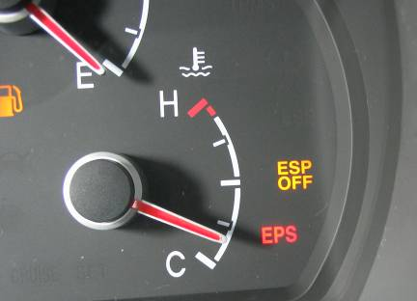
Diagnosis
Warning lamp
1) Warning lamp ON + Motor stop: Critical fault
- Torque sensor fault
- Motor or Relay fault
- MDPS ECM internal fault
- IG signal fault (from next power cycle)
2) Warning lamp ON + Motor assist: Minor fault
- CAN related faults
3) Warning lamp OFF + Motor assist: Minor fault
- ASP calibration failure
- Variant coding fault
- Vehicle speed signal fault
4) Warning lamp OFF + Motor stop
- Battery voltage high or low
Notes:
MDPS ECM으로부터 CAN을 통해 클러스터로 고장코드가 전송되고 이에 따라 CAN Cluster가 경고등을 제어함.
CAN 통신 선을 모두 Open시켜도 경고등 점등됨.

Slide 22
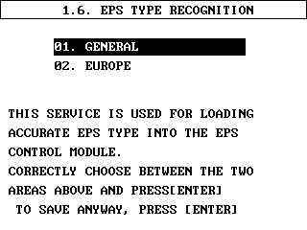
Diagnosis
Varient coding
Default
Notes:
유럽지역만 단품교환 시 이 작업이 필요하고 그 외 지역은 불필요함.

